Slide 1
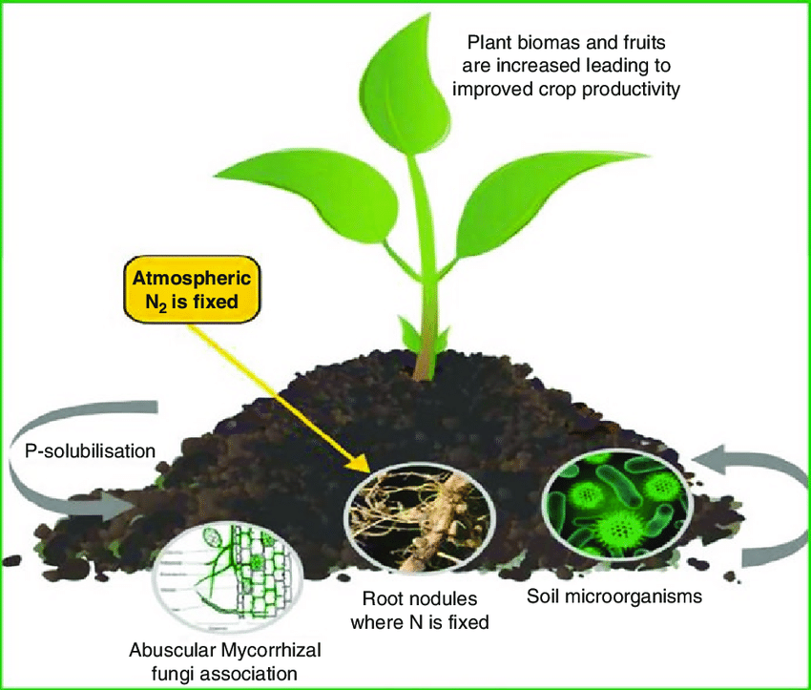


BIO – FERTILIZERS & BIO - PESTICIDES
www.siestogreen.com / siesto.green@gmail.com / Ph:- 8817400702

Slide 2
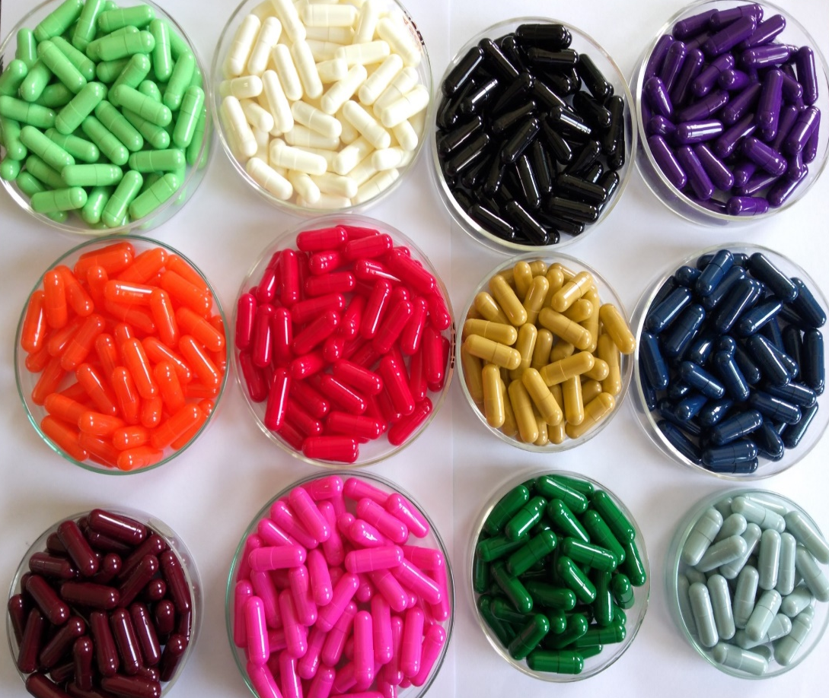
BIO – FERTILIZERS
&
BIO – PESTICIDES
IN
CAPSULE FORM
SIESTO SYSTEMS PVT LTD
WWW.SIESTOGREEN.COM
SIESTO.GREEN@GMAIL.COM
0091-9329294848
www.siestogreen.com / siesto.green@gmail.com / Ph:- 8817400702

Slide 3



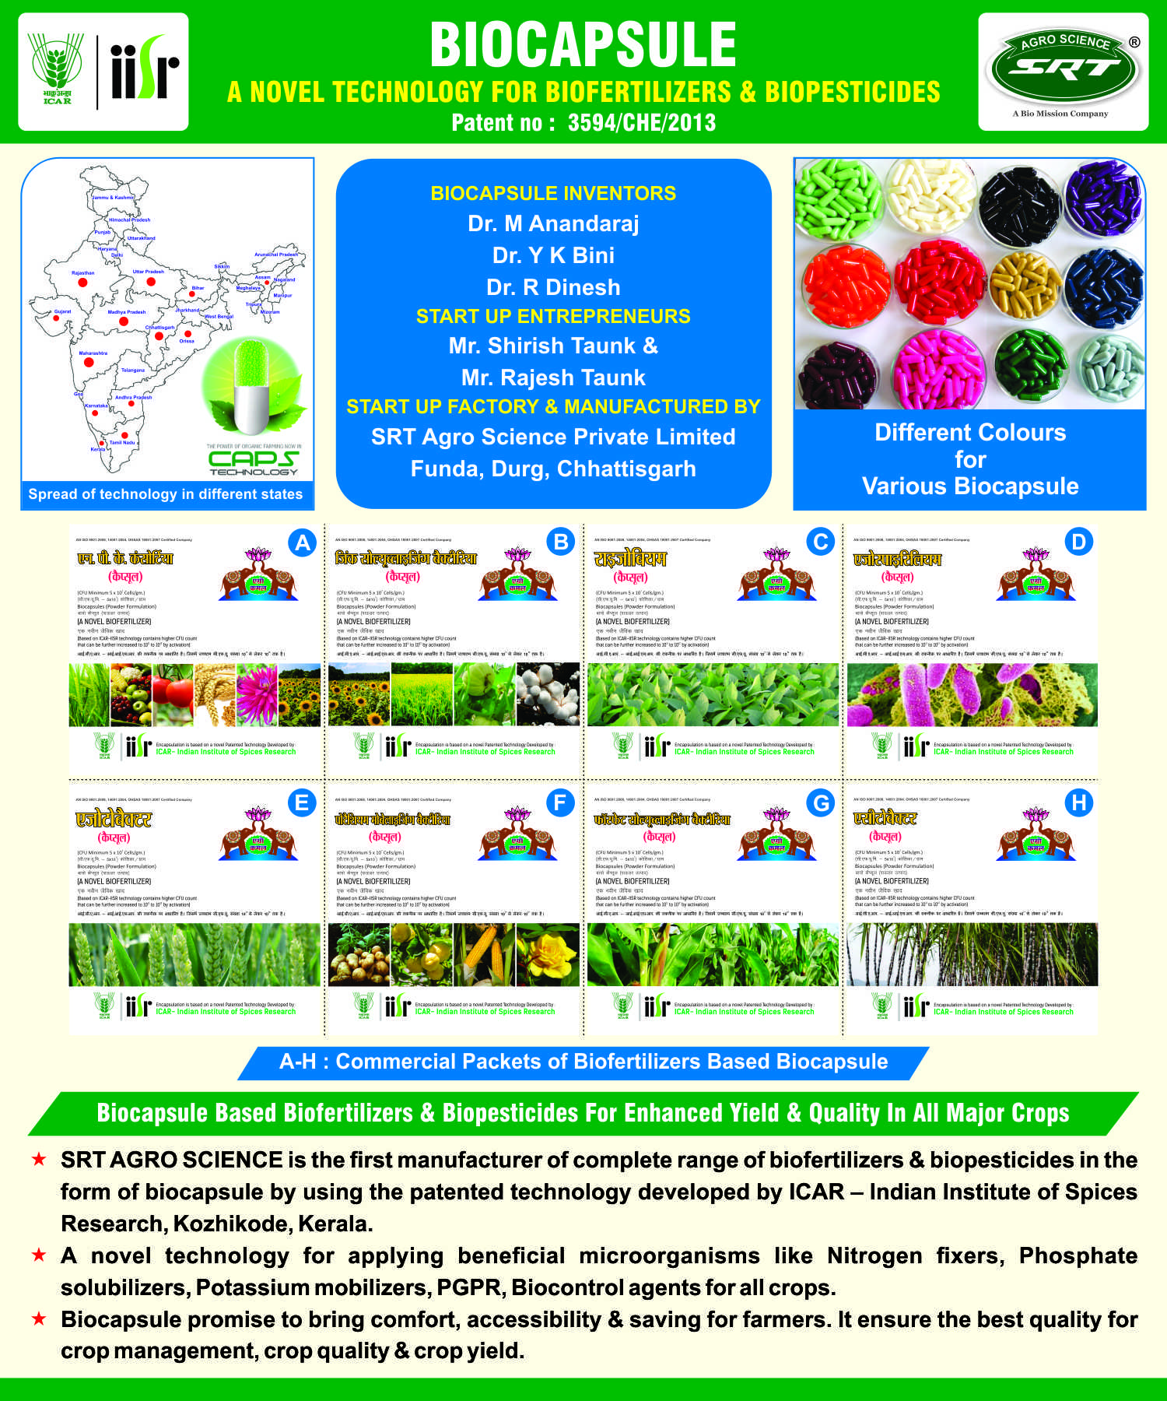
BIO CAPSULE’S
“A NOVEL METHOD OF STORING AND DELIVERING AGRICULTURALLY IMPORTANT MICROBES THROUGH BIOCAPSULES”

Slide 5
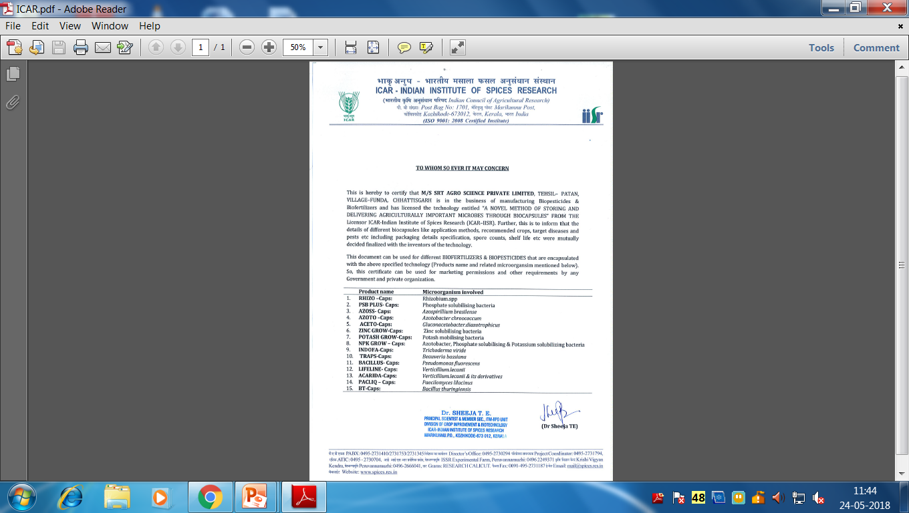
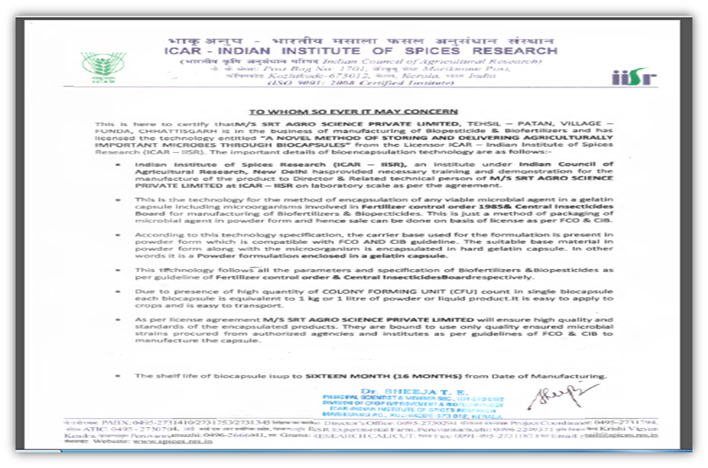
DECLARATION LETTER

Slide 6

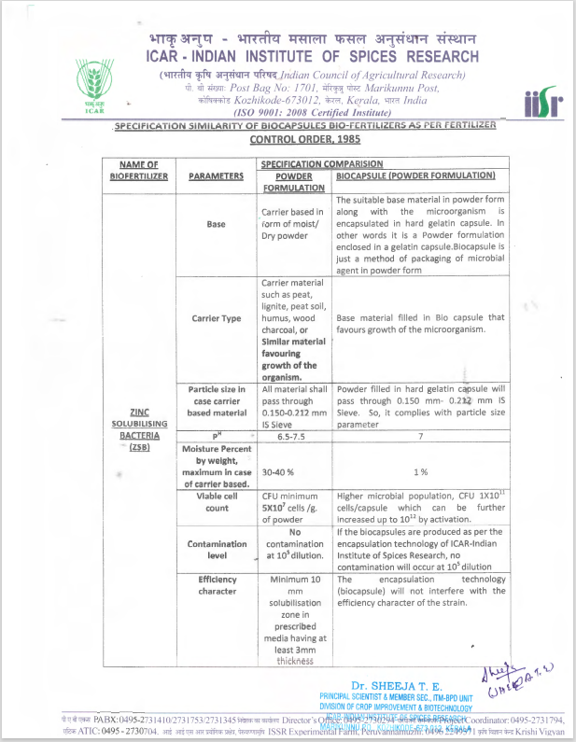
BIO CAPSULE SPECIFICATION
AS PER
ICAR - IISR

Slide 7
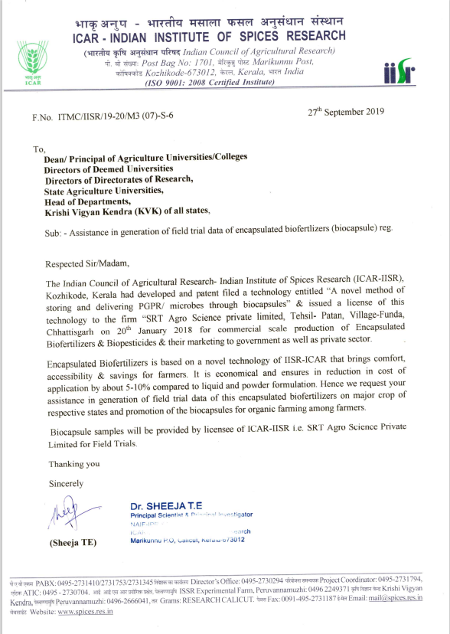
LETTER FROM
ICAR – IISR
TO
AGRICULTURAL UNIVERSITIES
DEEMED UNIVERSITIES
DIRECTORATES OF RESEARCH
KRISHI VIGYAN KENDRA

Slide 8
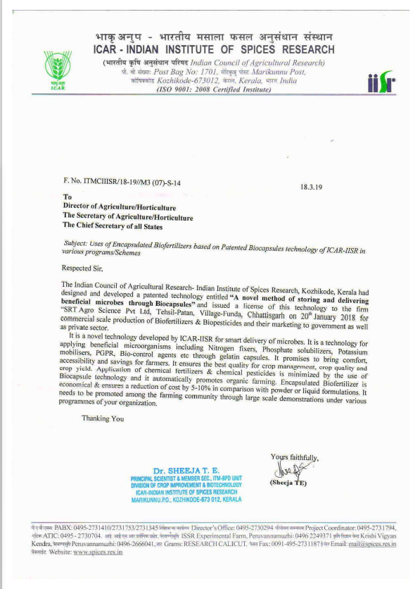
LETTER FROM
ICAR – IISR
TO
CHIEF SECRETARY OF ALL STATES
SECRETARY OF AGRICULTURE/HORTICULTURE
DIRECTOR OF AGRICULTURE/HORTICULTURE

Slide 9
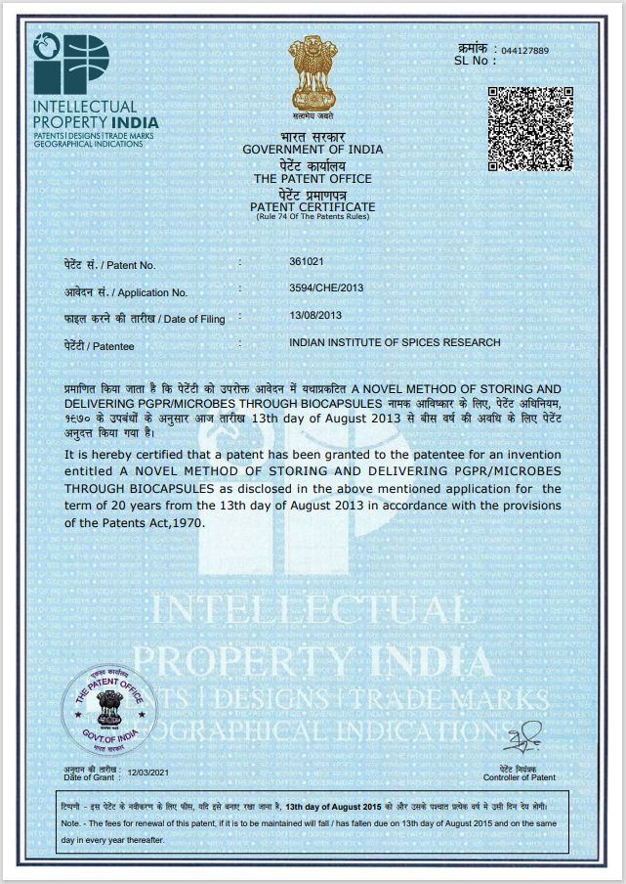
BIO CAPSULE PATENT CERTIFICATE
ICAR - IISR

Slide 10
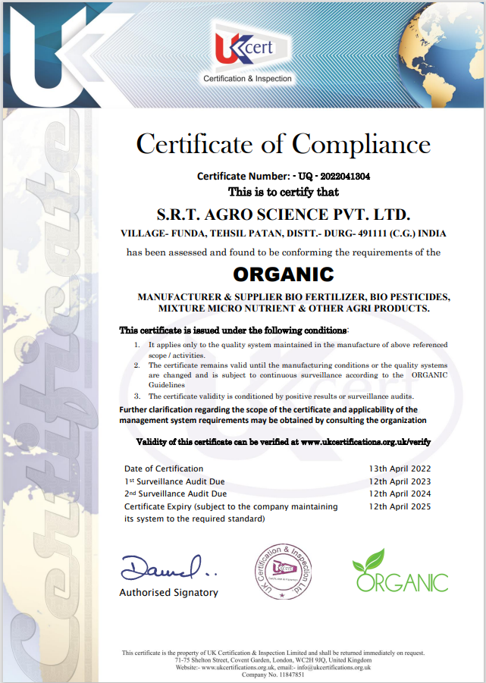
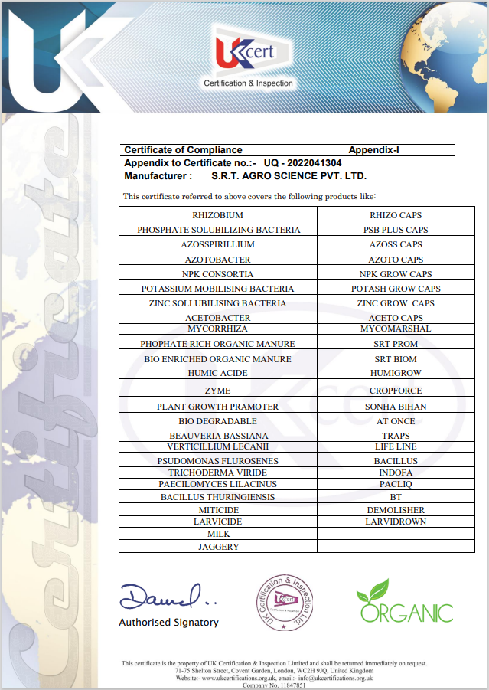
ORGANIC CERTIFICATION BY UKCERT

Slide 11
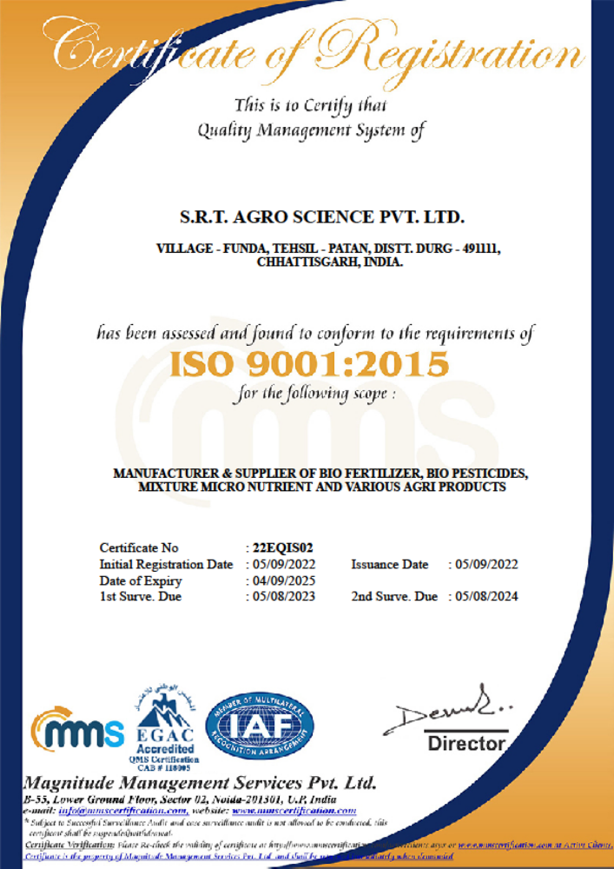

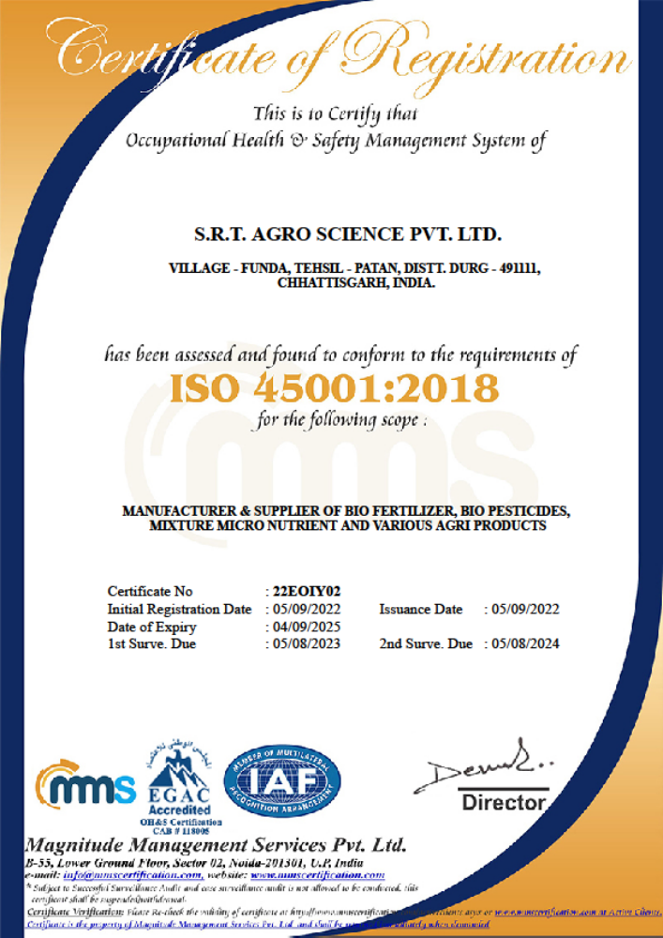
ISO Certifications
ISO 9001
ISO 14001
ISO 45001

Slide 12
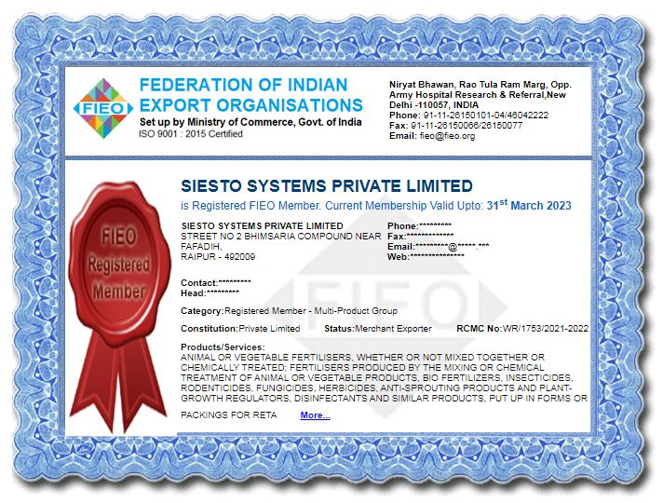
MEMBERSHIP CERTIFICATION
BY
FIEO

Slide 13

APPLIED
FOR CERTIFICATION

Slide 14
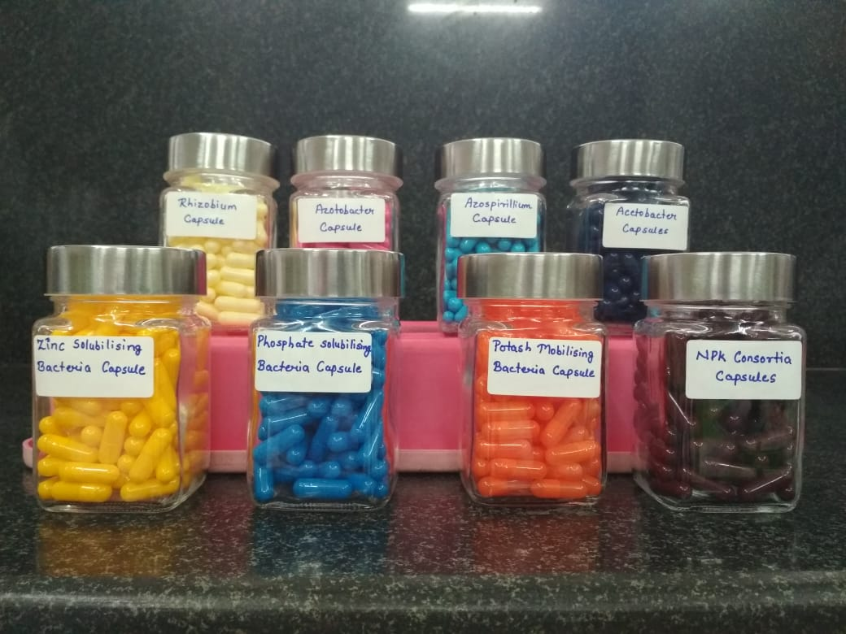

Slide 15

WHY ?
CAPSULE’S
www.siestogreen.com / siesto.green@gmail.com / Ph:- 8817400702

Slide 16
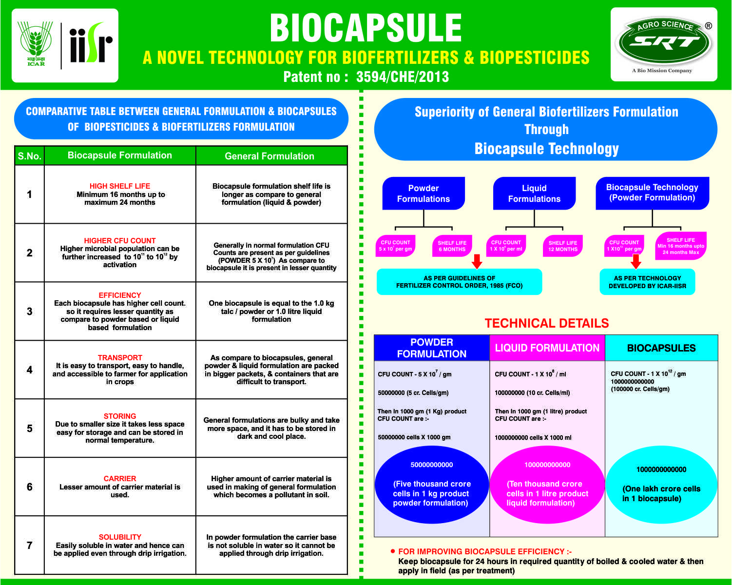

Slide 17


HIGHER CFU COUNT
BENEFITS OF BACTERIA
Number of bacteria’s available per square foot of agriculture land defines the quality of Soil, More the no. of bacteria better will be the soil condition
More bacteria’s will help plant to gather more nutrients from soil, which will increase the photosynthesis process in plant
More natural nutrients will help plants to sustain adverse climate conditions, drought, heavy rail, winds etc
These bacteria’s form colonies near rhizobirium of plant root system which help plant to resist soil borne diseases / fungal infections etc
Bacteria’s also help in retaining water in soil for longer durantion, which help plant to sustain without water for longer periods. Helping farmers to save water
Less quantity of bacteria will not bear the desired results, specially in soil where chemical fertilizers have been used in recent past
PER CAPSULE
www.siestogreen.com / siesto.green@gmail.com / Ph:- 8817400702

Slide 18

COMPARISON
POWDER
5,000 CRORE / 50 BILLION BACTERIA / KG
LIQUID
10,000 CRORE / 100 BILLION BACTERIA / LTR
CAPSULE
1,00,000 CRORE / 1 BILLION BACTERIA / NOS
COST / KG = 200/-
COST / LTR = 500/-
COST / CAPSULE = 340/-
COST / BILLION BACTERIA = 20 X 200 = 4000/-
COST / BILLION BACTERIA = 10 X 500 = 5000/-
COST / BILLION BACTERIA = 1 X 340 = 340/-
CONCLUSION – COST OF 1 BILLION BACTERIA FOR 1 ACRE OF FARM LAND IS MOST ECONOMICAL WITH CAPSULE

Slide 19
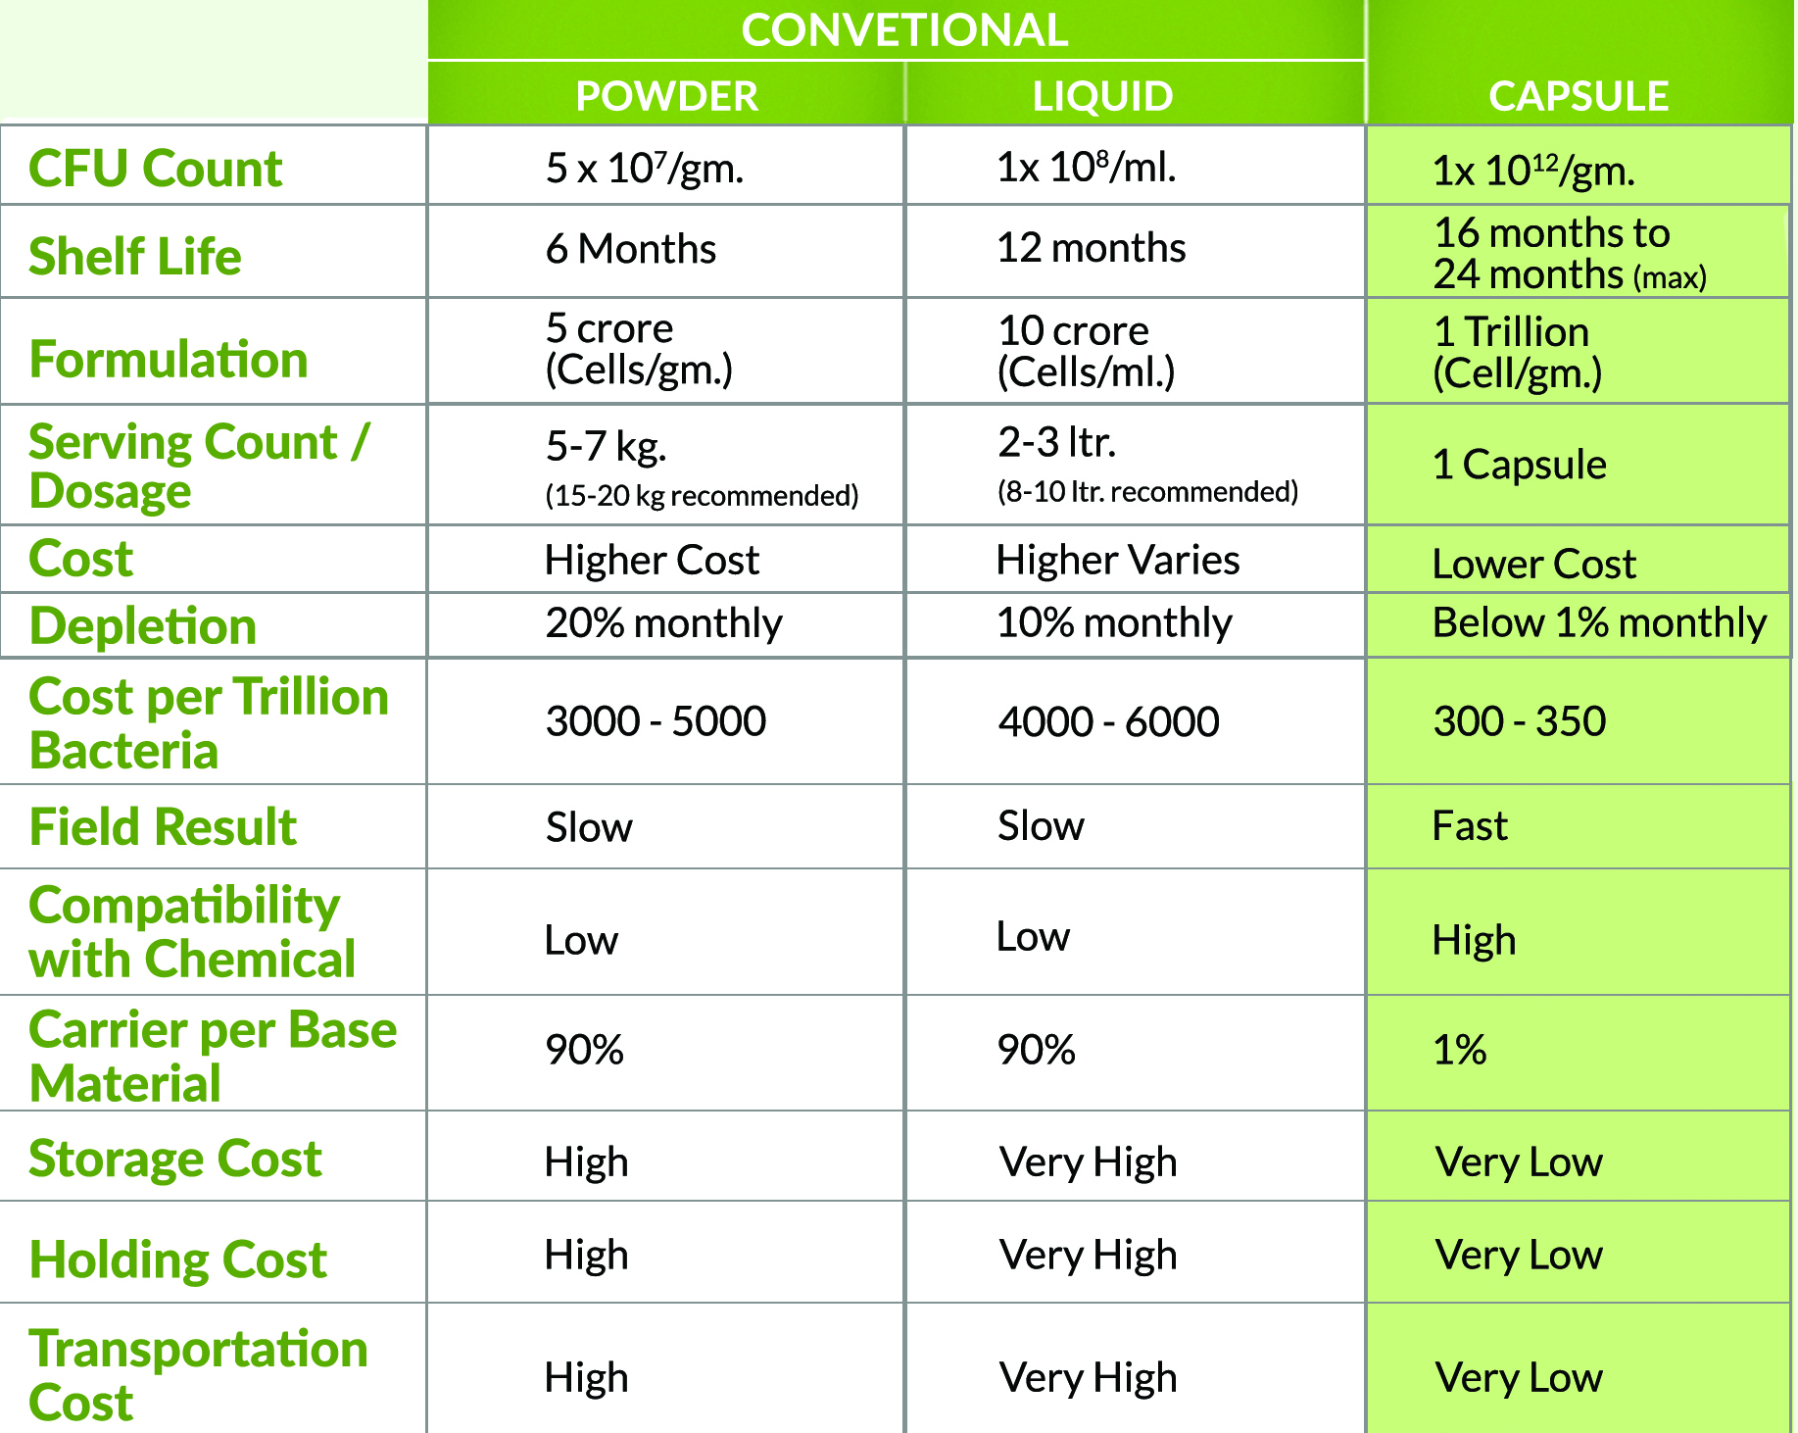
BIO CONVENTIONAL
V/S
CAPSULES

Slide 20
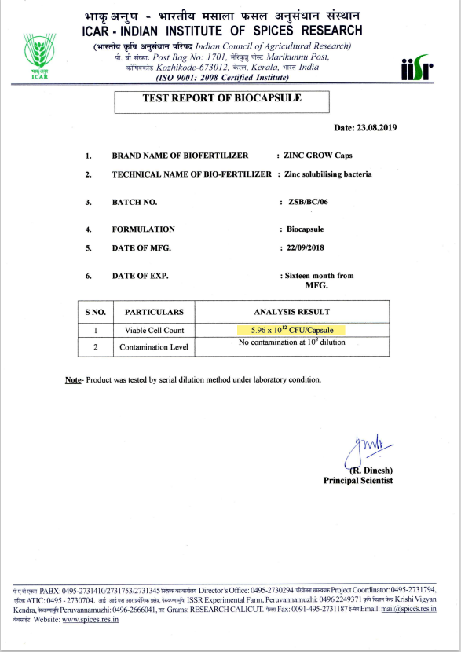
Test results for 1 capsule is 4 to 6 Times more then what we commit

Slide 21
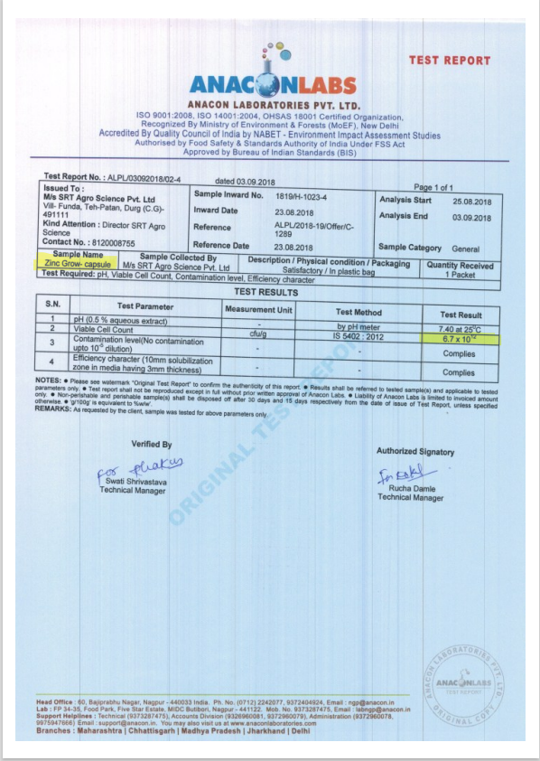

Slide 22

HIGHER SHELF LIFE
Powder Formulation Shelf Life is about 6 Months
Liquid Formulation Shelf Life is about 12 Months
Capsule Formulation Shelf Life is about 24 Months
Benefits of Higher Shelf Life
The longer shelf life gives consumers a larger window to consume the product
Better merchandising and product aesthetics drives more sales and ultimately less waste at retail
for exports, the strategic importance of shelf life increases even more
Higher shelf life reduces the cost of purchasing and repeated transportation, handling cost
In Powder & Liquid formulation as the time passes no of bacteria count reduces, whereas in capsule it remain same for 24 months
Shelf life is the length of time that a commodity may be stored without becoming unfit for use, consumption, or sale.
www.siestogreen.com / siesto.green@gmail.com / Ph:- 8817400702

Slide 23

EASY TO TRANSPORT
BENEFITS OF CAPSULE in transportation and handling
Capsule’s are Light in weigh and smaller in size, which makes them easy to transport
1 container of powder / liquid fertilizer is equal to 5 to 10 cartoons of Capsules
Transportation cost will be saved
Can be transported via Air – saving time and money
Farmers can save on labour handling cost
In most of the countries farmers don’t have labour, they have to themselves carry fertilizer’s from shop to farm
Application is also easy due to light weight and smaller size
Small quantities can be ordered online and can be delivered through courier service
Even ladies can handle and apply them on field without any trouble
EASY TO HANDLE

Slide 24

EASY TO SELL / TRADE ONLINE / OFFLINE
Easy to sell online through AMAZON, eBay, Alibaba, IndiaMart, TradeIndia etc
Easy to deliver through small vehicles, even 2 wheelers and back packs
Distributors / Dealers need not worry for sales team size & delivery Team
Retailers / Small Farmer do not require to maintain heavy stocks

Slide 25
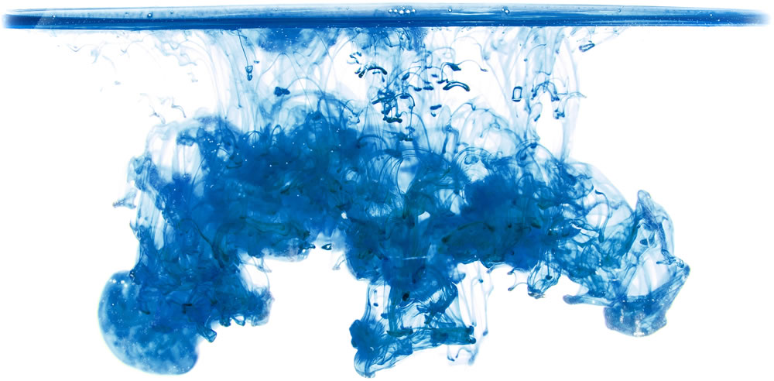
GOOD WATER SOLUBILITY
Can be used easily in drip irrigation systems
It wont chock the pipeline and taps in drip irrigation system
Can also be used with Drone Sprayer system
Good for Foiler spray
Good solubility means lesser quantity of carrier material
Good solubility means less wastage of product and better result

Slide 26


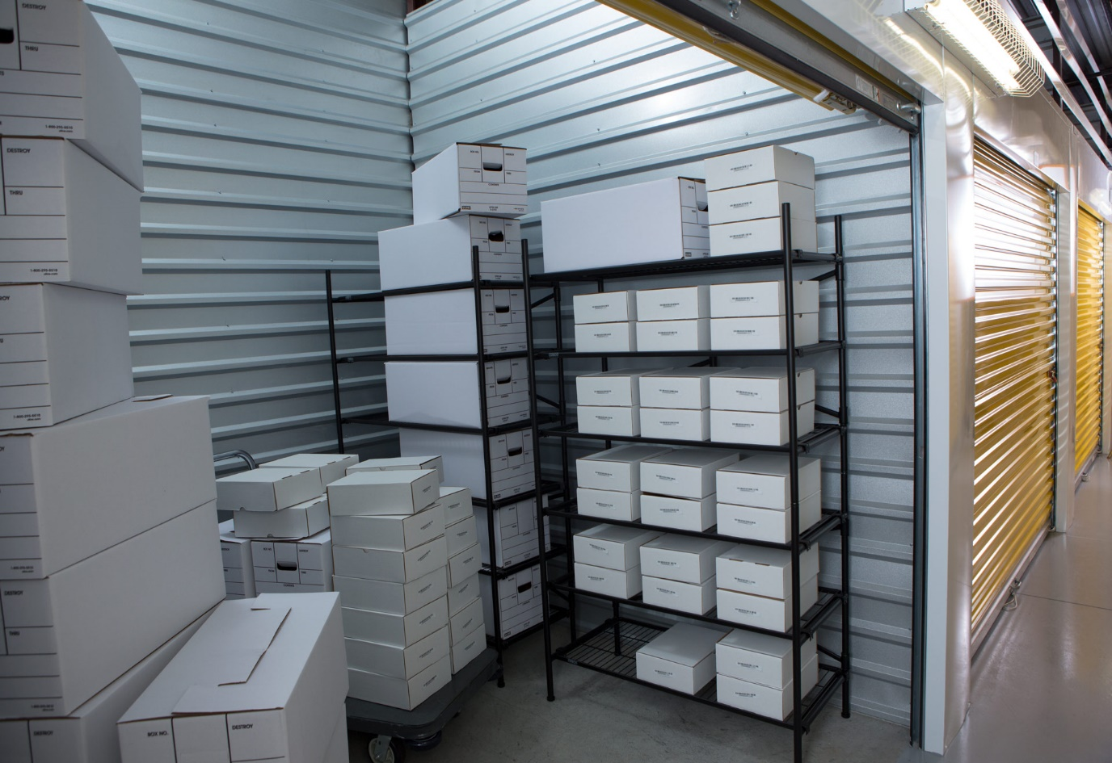
LOW STORAGE COST
LESS SPACE REQUIRED FOR STORAGE OF GOODS
SAVING IN SPACE COST COMPARED TO POWDER AND LIQUID
EASY TO TRACE AND DELIVER
CAN BE STACKED ON RACKS TO SAVE MORE SPACE IN STORE
IN MANY COUNTRIES / CITIES COST OF WAREHOUSES ARE VERY HIGH, CAPSULES SAVE ON COST AND BECOME’S MORE COMPETATIVE IN MARKET
LOW COST OF TRANSPORTATION
Saving in fuel cost
Less pollution due to many trucks
Fast movement of material
More Competative in market
Better margins
More saving
www.siestogreen.com / siesto.green@gmail.com / Ph:- 8817400702

Slide 27
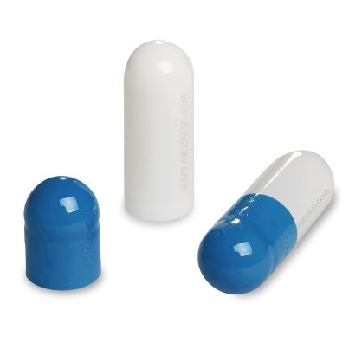
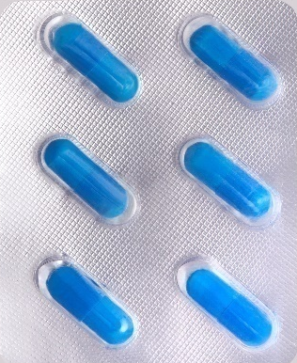

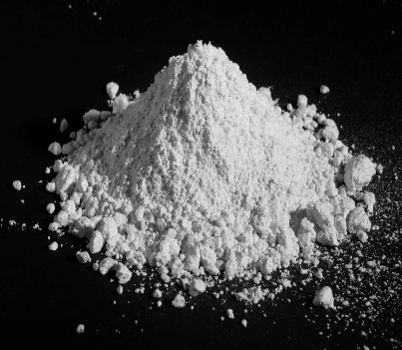

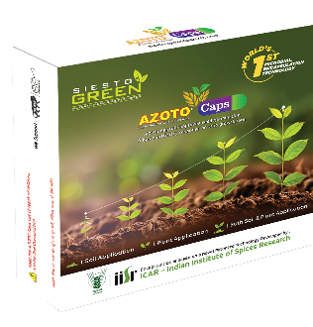
5 Layer Safety Packaging = better shelf Life up to 2 Years
Encapsulation
1st layer of safety - Gelatin Based capsule shells for better insulation and safety from external conditions
Blister Packing
2nd Layer of Safety - Seal packed Blister packing to make it water proof, and safe from external conditions
Box Packing
3rd Layer of Safety - Small Card board Box with lamination packing to save from temperature changes, Moisture and other external conditions
Highly concentrated culture formulation with 1 trillion CFU per Gram
Powder Formulation
4th Layer of Safety - 2nd Layer of Card Board box packing for proper storage, safety and mis handling
Jumbo Box Packing
Cartoon Box Packing
5th Layer of Safety - Top layer of Card Board Box for proper handing , safety from moisture, proper stacking etc

Slide 28

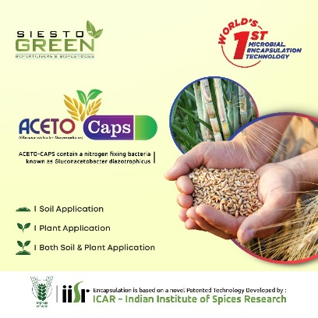
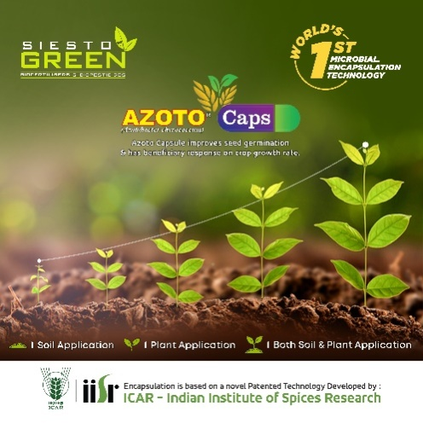


20’ Container Capacity for Private Labeled packet
Details | Capsules | Strips | Packet | Jumbo Box | Cartoon | Weight (KG)
2 Capsule Packed | 200000 | 100000 | 100000 | 5000 | 1000 | 2800
6 Capsule Packed | 600000 | 100000 | 100000 | 5000 | 1000 | 3800
Mix 50:50 (2:6) | 400000 | 100000 | 100000 | 5000 | 1000 | -
Mix 25:75 (2:6) | 500000 | 100000 | 100000 | 5000 | 1000 | -
Mix 75:25 (2:6) | 300000 | 100000 | 100000 | 5000 | 1000 | -
20’ Container Capacity for Unpacked Strips (Blister packing)
Details | capsules | Strips | Packet | Jumbo Box | Cartoon | Weight (KG)
2 Capsule Strip | 600000 | 300000 | Nil | 5000 | 1000 | 2400
6 Capsule Strip | 1800000 | 300000 | Nil | 5000 | 1000 | 3600
Mix 50:50 (2:6) | 1200000 | 300000 | Nil | 5000 | 1000 | -
Mix 25:75 (2:6) | 1500000 | 300000 | Nil | 5000 | 1000 | -
Mix 75:25 (2:6) | 900000 | 300000 | Nil | 5000 | 1000 | -

Slide 29

ADVANTAGE OF BIO CAPSULE FOR ENVIRONMENT
Water pollution will be reduced
Air pollution will be reduced
Acidification of the soil and mineral depletion of the soil can be controlled
Organic farming will help many Animals, Birds, Insects to Survive
Oxygen level will increase in air, carbon di oxide will reduce
Water Retention in soil and strong roots of plants will help in reducing soil erosion
Less use of Chemicals will help Many types of Micro organisms to develop and sustain
Less air pollution, due to less use of transport facilities.
www.siestogreen.com / siesto.green@gmail.com / Ph:- 8817400702

Slide 30


ADVANTAGE OF BIO CAPSULE FOR GOVERNMENT
Reduction in Input Fertilizers cost to all farmers
Easy to handle and deliver in all regions at very low cost
Upto 10% of increase in agricultural output
Increase in conversion of non farming land to farming land
Soil PH & Texture level will be controlled and benefitted
Increase of Organic carbon in Soil
Water pollution due to chemical fertilizers and pesticides will decrease
Oxygen percentage in air will increase
Soil water retention will increase
Plants strength and sustainability will be increased
Less damage to crops due to un timely rainfall and other seasonal effects
Food quality will be better due to reduction in chemical fertilizers
No side effects on Animals or reduction in health issues of Animals caused due to chemical fertilizers

Slide 31


ADVANTAGES OF BIO CAPSULE TO FARMERS
Cost of Input on Fertilizers will decrease up to 10%
Output will increase by at least 10%
Handling and storing of fertilizers cost will decrease
Land overall PH Level, Texture and organic carbon will increase
Less damage to crops due to un timely rainfall and other seasonal effects
No side effects on human body due to Pesticides
Water retention in soil will increase, so less water be required for farming
www.siestogreen.com / siesto.green@gmail.com / Ph:- 8817400702

Slide 32

ADVANTAGES OF BIO CAPSULE TO
DISTRIBUTORS / DEALERS / RETAILERS
Huge Scope being Patented Technology
Good Margins, less wastage, easy to manage.
Handling and storing of capsules is very low compared to chemical and other bio fertilizers like liquid based or powder based
Bright Future as Bio / Organic is the future of farming, use of chemicals are declining day by day and most of the government are now encouraging farmers for organic farming
Innovative distribution network through Franchising, a proven technique for accured sales network, SIESTO will help your team in developing system for your country
Each Country 1 or 2 distributors subject to geographical strategy, we can also supplied in Private lableing
Support for Online sale, Government sale, Bulk Sales etc

Slide 33


Hilly Area Benefits
Easy to transport
Easy to Apply
Easy to store
Easy to carry on foot
Better results
Environment friendly
Reduces wastages of packaging
Reduced transportation on narrow hilly road
www.siestogreen.com / siesto.green@gmail.com / Ph:- 8817400702

Slide 34
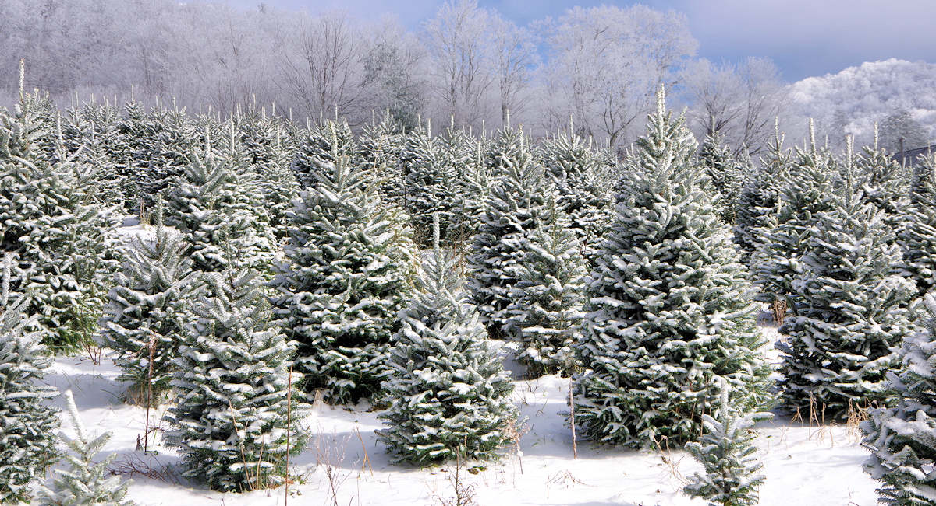
SNOW COVERED FARM LAND
Easy to transport & Store
Easy to Apply
Good Shelf Life
Easy to carry on Small trucks / cars
Microbes that can sustain Cold Weather
Microbes that can store more nutrients for Winter’s to pass
Better results
Environment friendly
Reduces wastages of packaging
www.siestogreen.com / siesto.green@gmail.com / Ph:- 8817400702

Slide 35
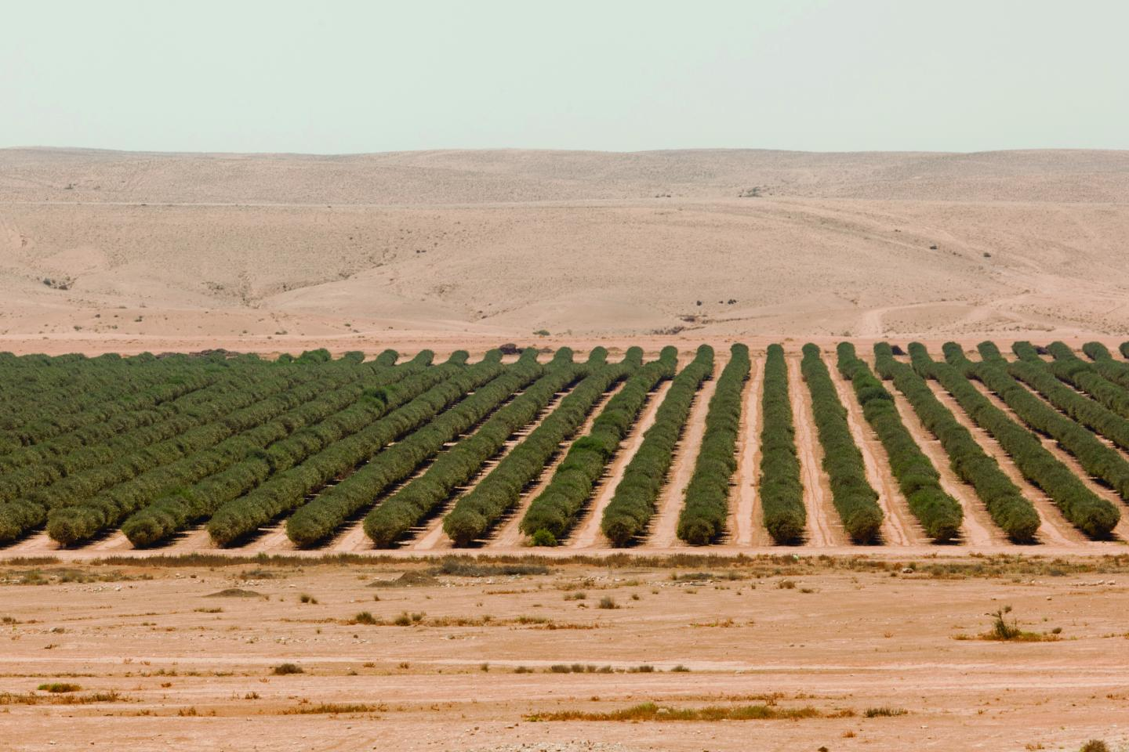
DESERT FARMING LAND
Easy to transport & Store
Easy to Apply
Good Shelf Life
Easy to carry on Small trucks / cars
Microbes that can sustain hot and dry climate
Microbes that can store more nutrients with less water
Increases water retention in soil
Helps plant sustain in harsh conditions
Converts sand into fertile soil
Economical then other alternatives
Better results
Environment friendly
Reduces wastages of packaging
www.siestogreen.com / siesto.green@gmail.com / Ph:- 8817400702

Slide 36

SMALL ISLANDS FARMS / FOREST
Easy to transport & Handle
Easy Application
Easy to store
Good Shelf Life
Easy to carry on boat / sea planes
Better results
Environment friendly
Reduces wastages of packaging
Reduced transportation to remote islands
www.siestogreen.com / siesto.green@gmail.com / Ph:- 8817400702

Slide 37
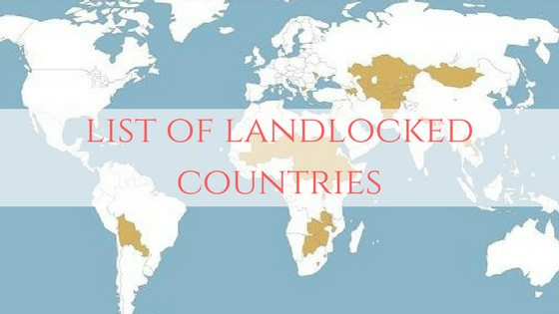
LAND LOCKED COUNTRIES
Easy to transport & Handle
Easy Application
Easy to store
Good Shelf Life
Easy to carry small Planes / small trucks
Better results
Environment friendly
Reduces wastages of packaging
Reduced transportation to far away and remote places
www.siestogreen.com / siesto.green@gmail.com / Ph:- 8817400702

Slide 38

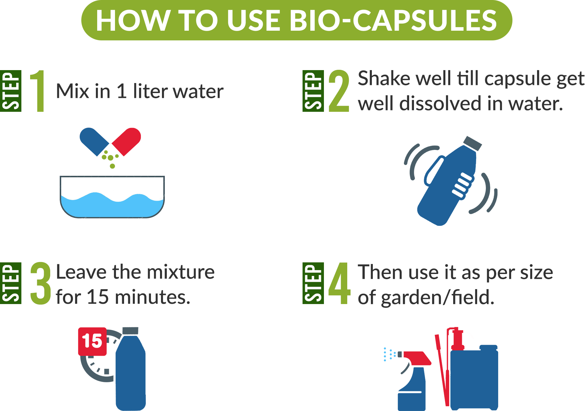


Slide 39
INFRASTRUCTURE
www.siestogreen.com / siesto.green@gmail.com / Ph:- 8817400702

Slide 40
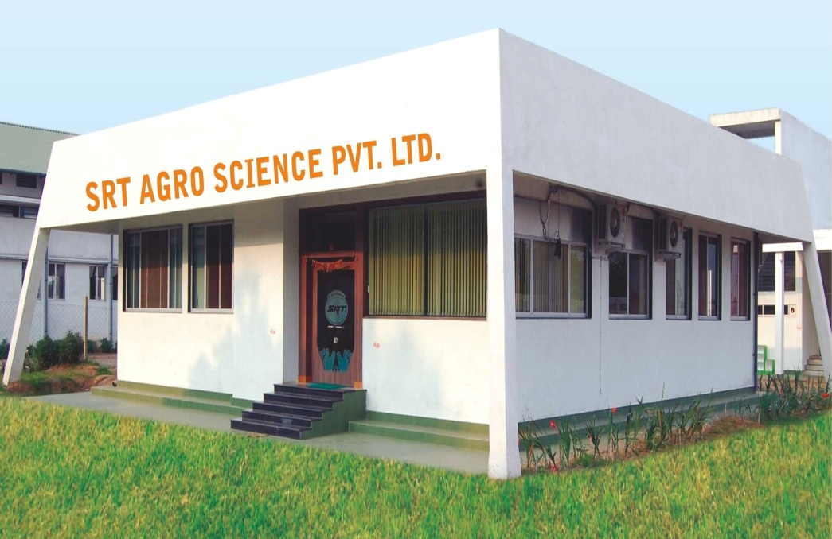
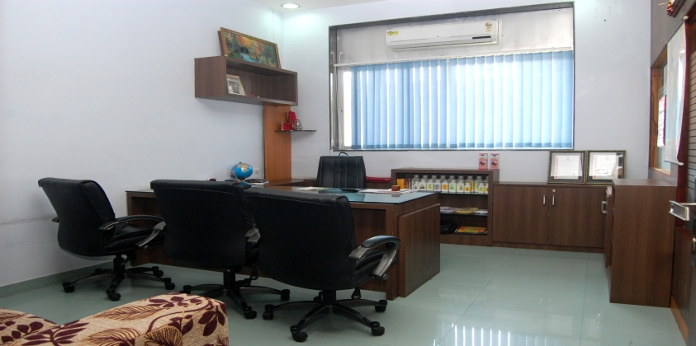
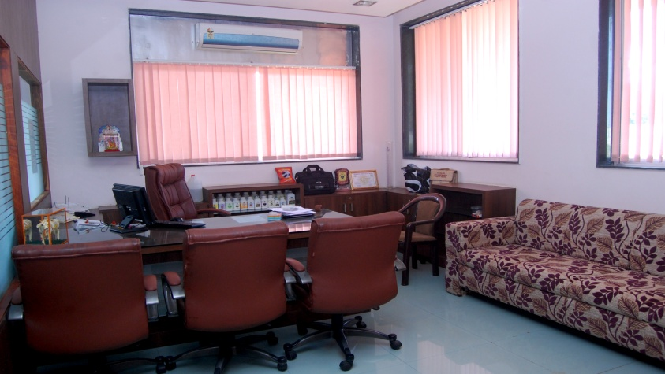
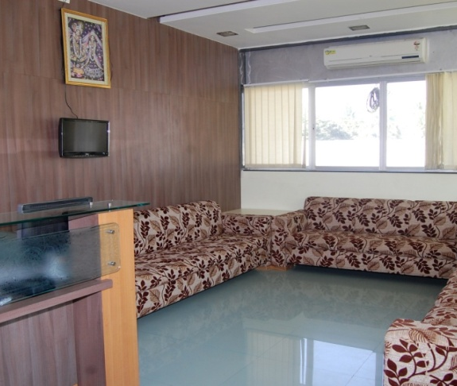
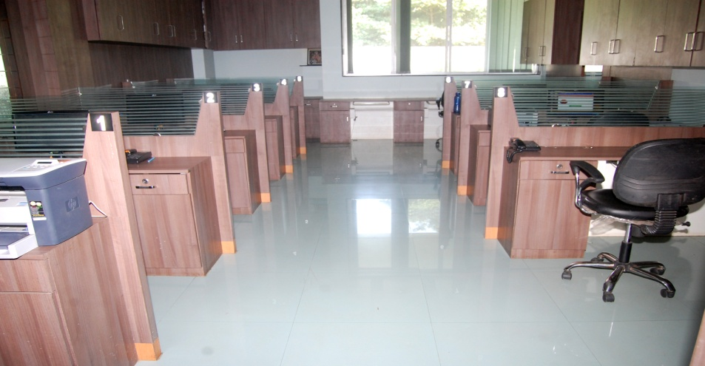
Admin Office

Slide 41
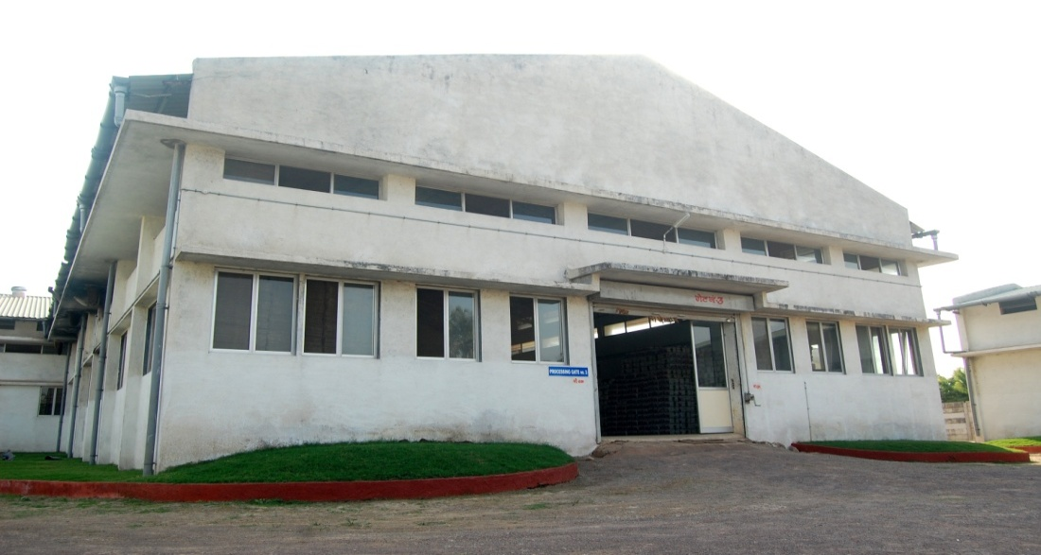
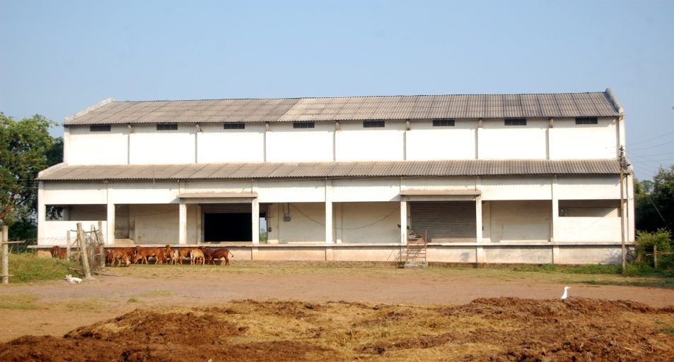
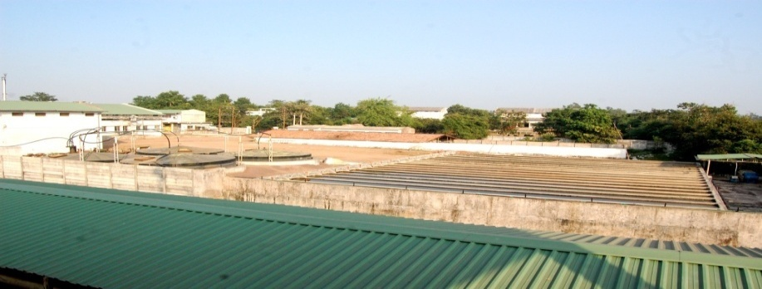
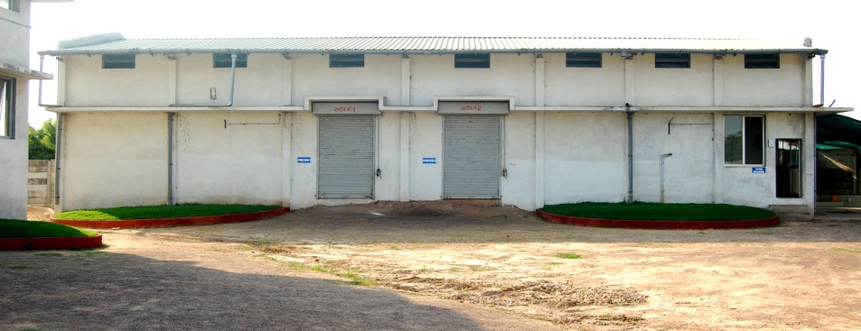
Plant infrastructure

Slide 42
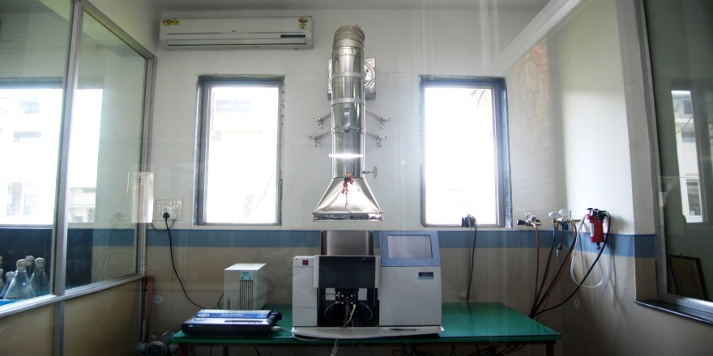
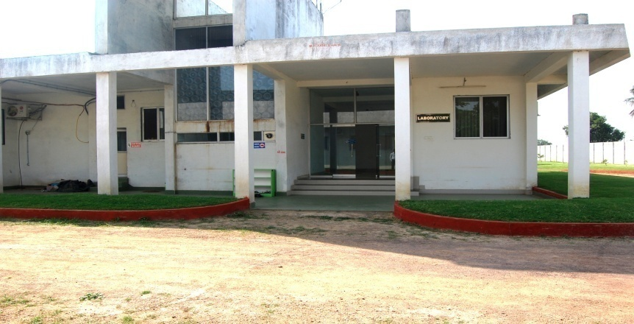
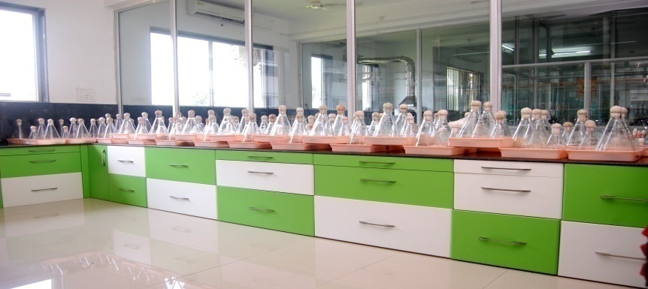
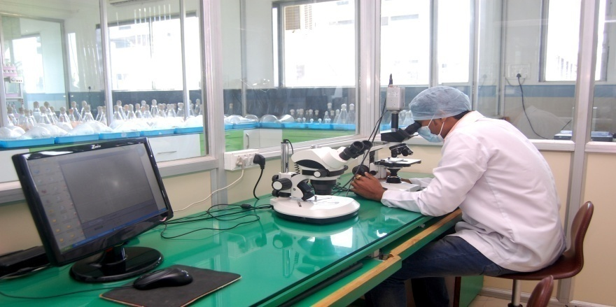
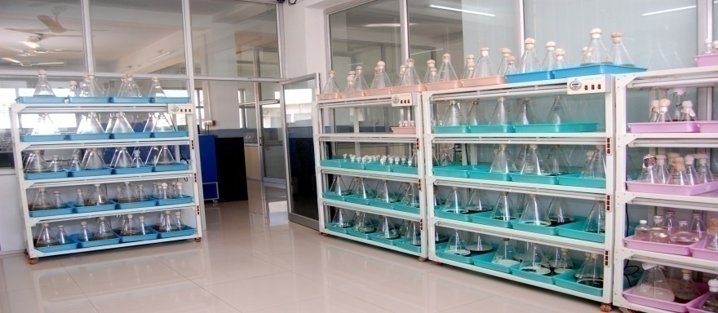
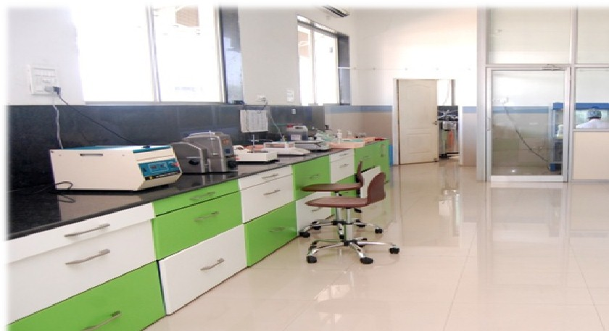
LABORATORY

Slide 43
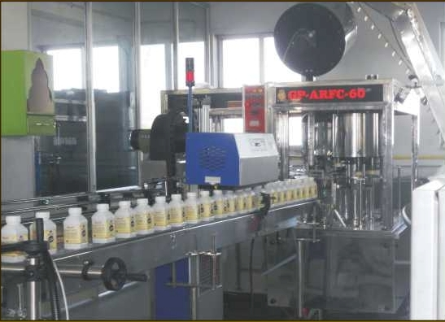
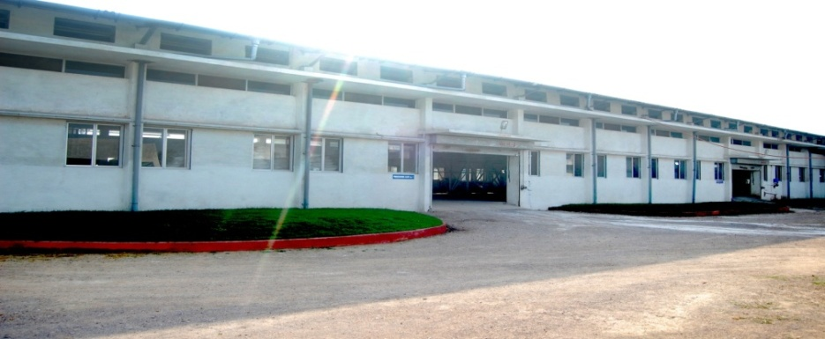
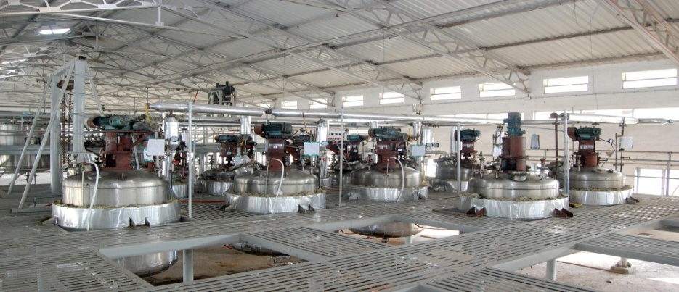
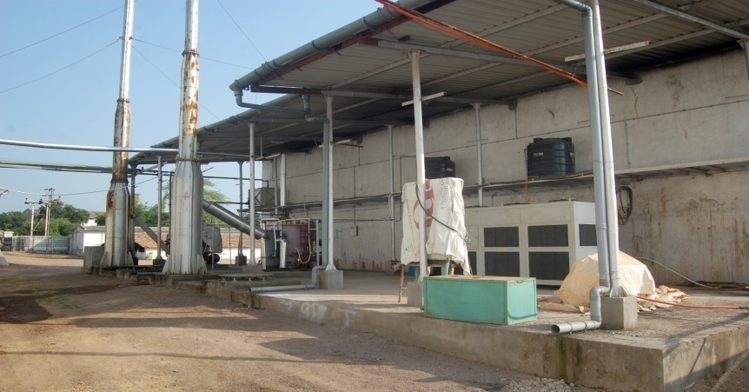


Processing unit

Slide 44





Raw material process

Slide 45



Farmers training hall

Slide 46

Export Documents List
Bill / Invoices as per Export Norms
Packaging List As per Norms
Origin Certificate
Bill of Lading (Post Shipment)
Product Wise HSN Code
IEC Certificate
GST Certificate
PAN Certificate
Insurance (If Required)
Test Certificates (Lot Wise)
MSDS Report
Manufacturing Licenses (If Required)
License to export Fertilizers (If Required)
Non Hazards Declaration Certificate
InCo Terms – FOB / CIF / CNF / Ex Factory
www.siestogreen.com / siesto.green@gmail.com / Ph:- 8817400702

Slide 47

Importers Documents Required
IEC Certificate
Company Registration Proof
Tax Registration Proof
Import Permission for fertilizers
University test certificate (Importing country) if applicable
Toxicity Data (if applicable)
Container Report
Shelf Life Certificate ( Importing country) (if applicable)
Trail Data (if applicable)
Registration of Products (if applicable)
Importing Country wise any other documents (if any)
www.siestogreen.com / siesto.green@gmail.com / Ph:- 8817400702

Slide 48

International Distributor Norms
Deposit of $100,000 for Country Rights
Distributor agreement
Must have/apply all required Licenses
2 years agreement to be renewed subject to performance
Investment Capacity $1 Million initial, then at least 1 month stock capacity
Distributors with past experience will be preffered
Getting Brand registered with all concerned Govt department
Liasioning for tenders with Various Departments
Developing and maintaining Franchise Network as per norms
Online Sales Management team to be maintained
Big farmers corporate account Managers to be appointed
Societies and various farmers Organizations to be approched for field trials
Agri Consultants / Influencers must be approched and briefed about Brand
Major Agri expo’s must be participated within Country
Payment terms – 100% advance or 30% Advance balance LC at Sight (CD to be provided by company)
www.siestogreen.com / siesto.green@gmail.com / Ph:- 8817400702

Slide 49

International White / Private Labelling Norms
Deposit of $150,000 for Country Rights & Private Labeling
Private / White Labelling Agreement
Must have/apply all required Licenses
2 years agreement to be renewed subject to performance
Minimum 1 x 20’ Container Order initially
Annual target as per market size of the concerned country, Minimum $10 Million
Payment terms – 100% advance or 30% Advance balance LC at Sight (3% CD to be provided by company)
Non Disclosure Agreement, No Cross Selling commitment, No export to other countries
No misuse commitment
Packaging designing to be provided (optional)
We can supply Strips (without packet) or with packet
Only 1 country rights will be allowed per agreement
www.siestogreen.com / siesto.green@gmail.com / Ph:- 8817400702

Slide 50
CROP SCHEDULE – SEED SOWING
SOIL PREPRATION
MYCORRHIZA
SEED TREATMENT
INDOFA + BACILLUS
MONTHLY CYCLE 30 DAYS / 60 DAYS / 90 DAYS / 120 DAYS / 150 DAYS / 180 DAYS / 210 DAYS / 240 DAYS / 270 DAYS / 300 DAYS
POORNIMA CYCLE (3 DAY WITHIN FULL MOON)
NPK
BIO FERTILIZERS – AZOSS / AZOTO / ACETO / RHIZO, PSB, ZINC, POTASH
PROM
NPK
PGPR – CROP FORCE
ZINC
AMAVASYA CYCLE (3 DAY BEFORE DARK MOON)
PGPR – HUMI GROW
CROP PROTECTOR
PRE FLOWERING / FLOWERING / FRUITING
PGPR – SONHA BIHAAN
MICRO NUTRIENT - ALP
Any 1 of above alternate month

Slide 51
CROP SCHEDULE – RE-PLANTING
NURSERY
INDOFA + BACILLUS
MONTHLY CYCLE 30 DAYS / 60 DAYS / 90 DAYS / 120 DAYS / 150 DAYS / 180 DAYS / 210 DAYS / 240 DAYS / 270 DAYS / 300 DAYS
POORNIMA CYCLE (3 DAY WITHIN FULL MOON)
NPK
NPK + ZINC
PGPR – CROP FORCE
ZINC
AMAVASYA CYCLE (3 DAY BEFORE AND AFTER DARK MOON)
PGPR – HUMI GROW
CROP PROTECTOR
PRE FLOWERING / FLOWERING / FRUITING
PGPR – SONHA BIHAAN
MICRO NUTRIENT - ALP
Any 1 of above alternate month
TRANS- PLANT SOIL PREPRATION
INDOFA + BACILLUS
NPK + ZINC
PROM
MYCORRHIZA
PROM + BIOM
INDOFA + BACILLUS

Slide 52


ORGANIC FARMING
VS
CHEMICAL FARMING
www.siestogreen.com / siesto.green@gmail.com / Ph:- 8817400702

Slide 53


Slide 54
Organic Farming | Chemical Farming
By adopting Organic Farming, there is absolutely no possibility of the risk of deadly diseases like Cancer in Humans. | Insecticides and Pesticides used in Chemical Farming can cause Deadly dieses like cancer to Farmers and Human Beings.
No genetic disorder/distortion occurs in Human Beings and Other Beings with organic Farming. | Many kinds of Genetic Disorders occur in Human Beings and other beings with the use of Chemica Farming.
With organic farming, no poisonous impact happens to well water and other sources like well, ponds and rivers. | Various kinds of chemicals used in chemical farming have poisonous impact on all sources of water.

Slide 55
Organic Farming | Chemical Farming
Using organic farming, our friendly insects and other organisms like Honeybee, Bumblebee , Earthworm etc doesnot get effected and they are safe. | Using Chemical Farming, hamrful impact occur on our friendly insects and other organisms like Honeybee, Bumblebee, Earthworm etc, due to which important process like pollination and fertilization get effected.
There is increase in beneficial micro-organisms like P.S Bacteria, Rhyzobium Bacteria and other Nitrogen fixing bacteria with the use of Organic Farming due to which soil gets more fertile. | There is a harmful impact on beneficial bacteria and other micro-organisms present in soil with the use of Chemical Farming.

Slide 56
Organic Farming | Chemical Farming
Crops and their products produced by Organic Farming doesnot contain any kind of poisonous/ harmful leftover. | Crops produced by chemical farming contain toxic checmicals remains in excessive quantity, due to which various kinds of diseases occurs in Humans and other organisms.
By organic farming, no resistive capacitive of disease causing insects increases. | Pesticides and fertilizers used in chemical farming develops resistance in disease causing insects against these chemicals, due to which quantity of these chemicals is increased to control diseases, and thereby crops and their products have excessive amount of toxic remains.

Slide 57
Organic Farming | Chemical Farming
By Organic Farming, Our environment does not get any kind of pollution via air pollution, water pollution and land pollution. | With chemical farming, environment is polluted in various forms like air pollution, water pollution and land pollution.
Organic pesticides and fertilizers used in organic farming do not cause any harmful health impact on farmers. | Due to various types of toxic chemicals used in chemical farming, farmers suffer from symptoms like eye irritation, chest pain, vomiting etc.

Slide 58






Siesto Green Also Available at following Links

Slide 59


CONTACT DETAILS
VIKAS AGRAWAL
93292 94848
SIESTO.GREEN@GMAIL.COM
WWW.siestogreen.COM

Slide 60
THANK YOU….

